Slide 1

FOMO
ReInventing NYUAD – HackAD Hackathon 2022
Akram Khairi
Seyed Ali Madani

Slide 2
What is the problem?
There has been a recent boom in events on campus after the pandemic as many students are excited to attend in person events after a long time.
However, many students miss out on events they wish to go to as the current ways of finding out about events are lackluster (Posters & Engage)

Slide 3
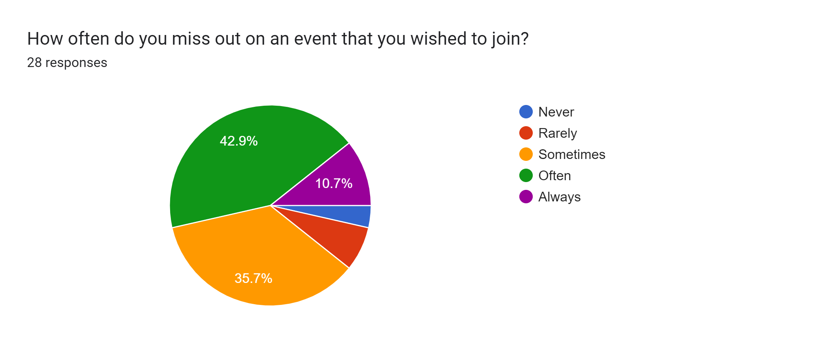
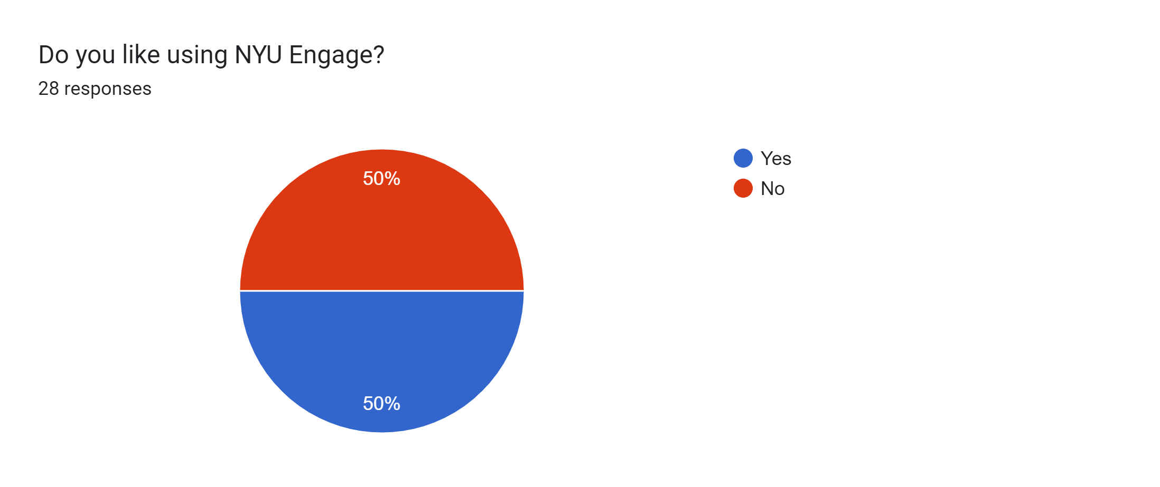
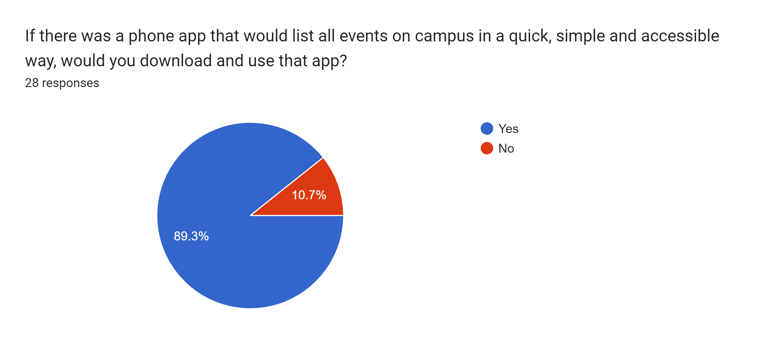

Slide 4


Slide 5
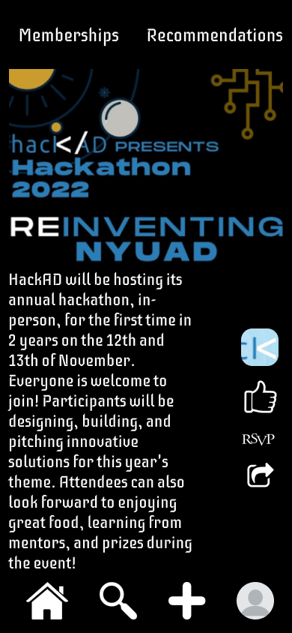
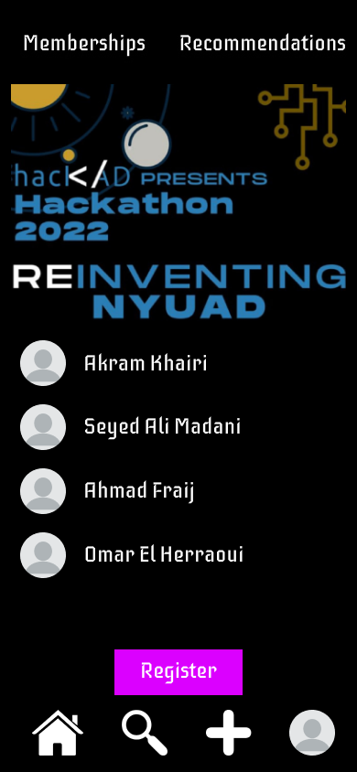

Slide 6
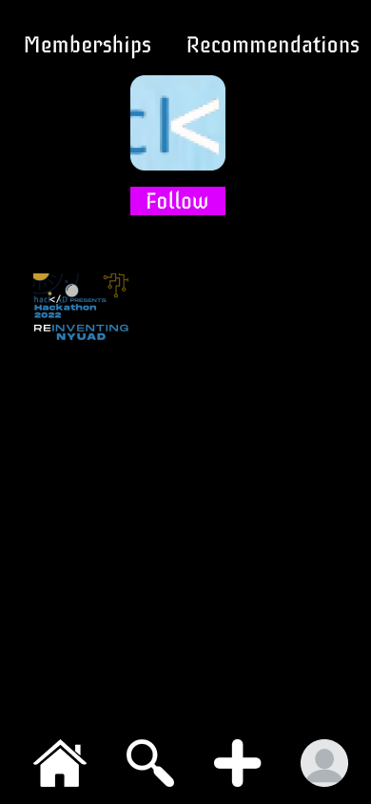
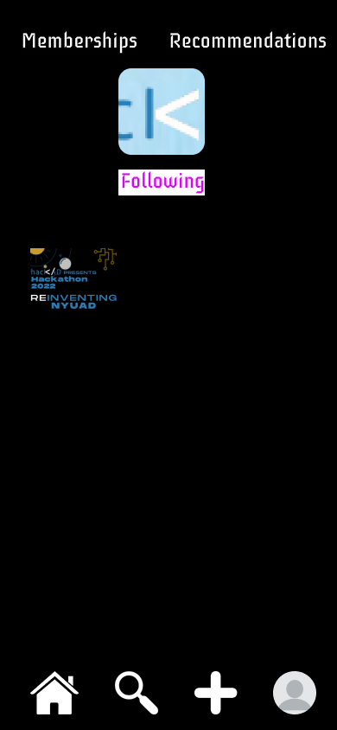

Slide 8
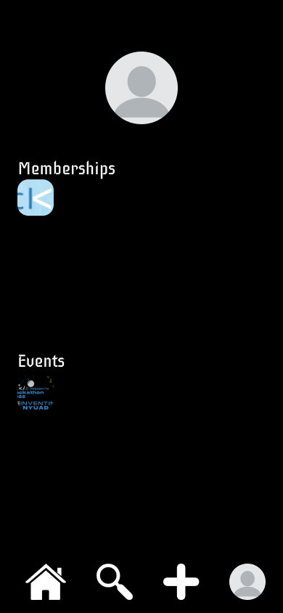
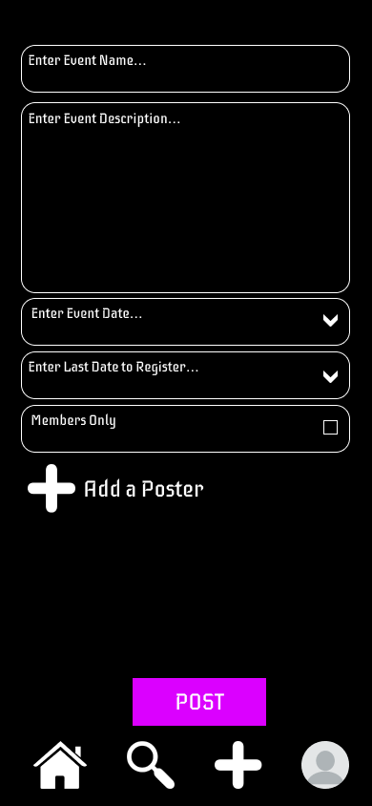
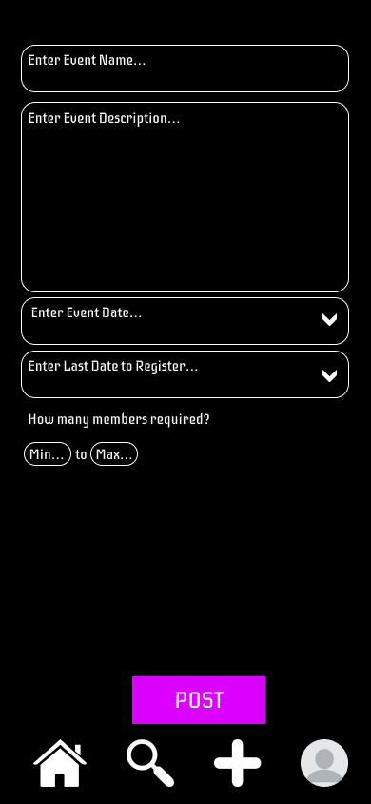
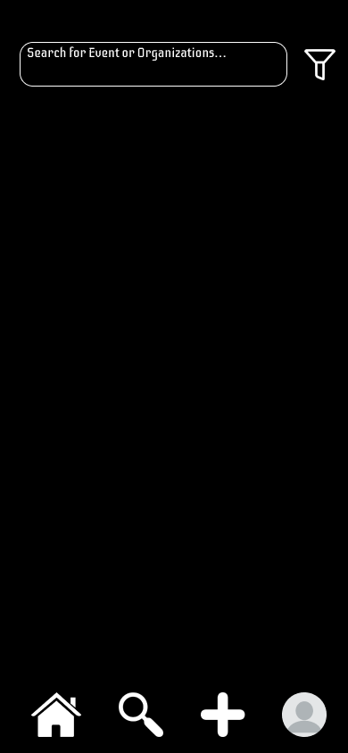

Slide 9
Future Plans
Integrate NYU SSO Login
Community Events
Booking Spaces on Campus through app
Payments
Percent of Recommendation leading to better event recommendations in the future

Slide 10
FOMO

